Slide 1
Academic Advisor
Jacob Foster, Utkarsh Jain, James Liu, Tyler O’Connell, Shawn Wu, Hiuyau Yan, Skylar Yan

Slide 2
Project Abstract
An Android application which helps students pick courses that align with their academic needs and personal interests
Easy access to list of courses, course information/progression, and past experiences

Slide 3



Specifications
Ranks potential courses based on factors such as average GPA in the course, relation to major, interests of the user etc and then give suggestions to the user
Shows potential future sequences for courses and only suggest courses which don't conflict with courses a student is already enrolled in

Slide 4






Design and Tools
Mobile Development
Java
Python
Android Studio
Android Simulator
JSoup
BeautifulSoup
Selenium
MySQL
Android JUnit
Version Control
Git

Slide 5
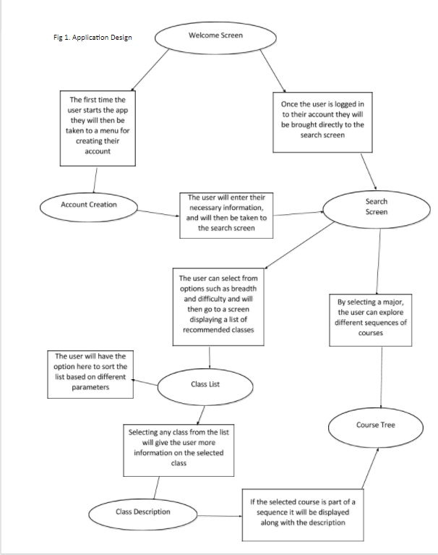
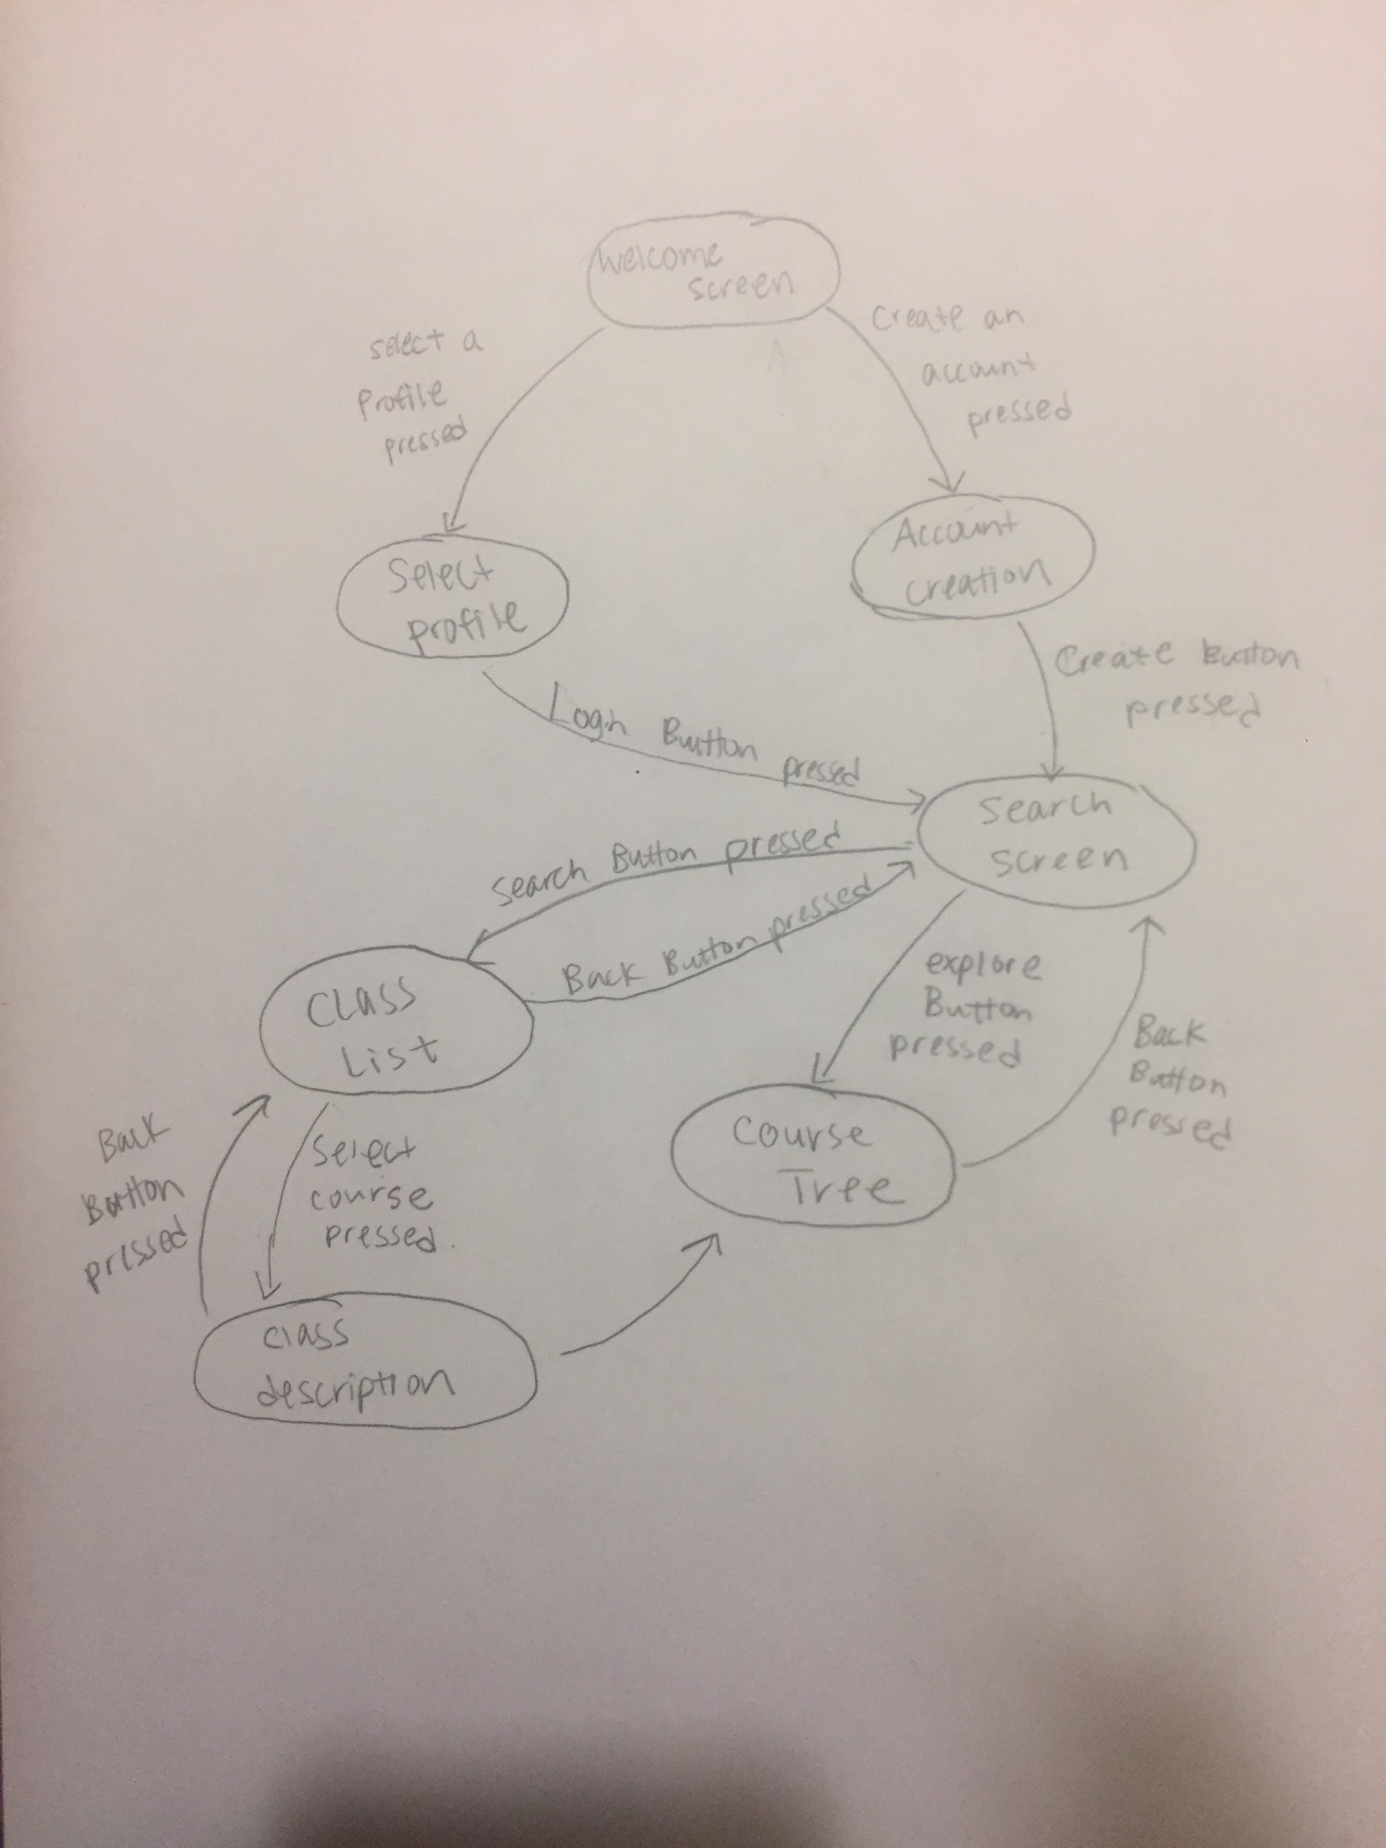
User Interface

Slide 6
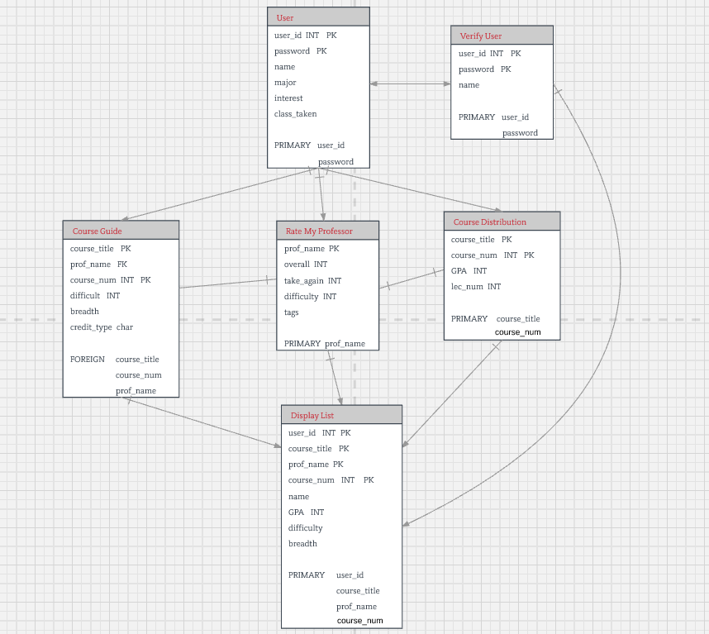
Database Structure

Slide 7
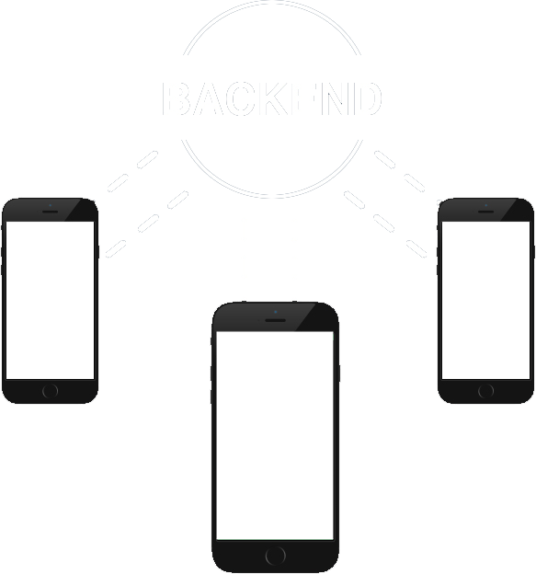

Data Aggression Flow
Web scraping,
PDF scraping
Data join
Storage

Slide 8


Architecture
Android frontend
Spring Boot with RESTful API
JSoup
Selenium
Apache PDFBox
MySQL database

Slide 9
What We Accomplished

Slide 10



Hardware
Setup our own server
$$$
How?
(optional) Domain name registration
DDNS with no-ip
Persistent bridge
Kernel-based Virtual Machine (KVM)
Ubuntu
Git, Java, Python, MySQL
Selenium, Geckodriver

Slide 11

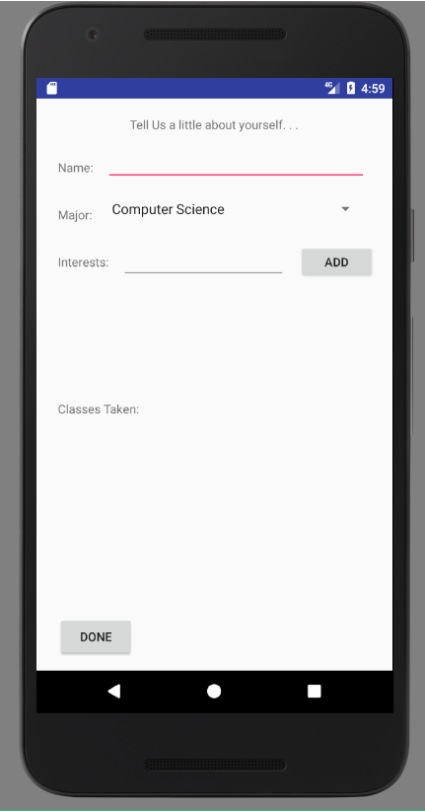
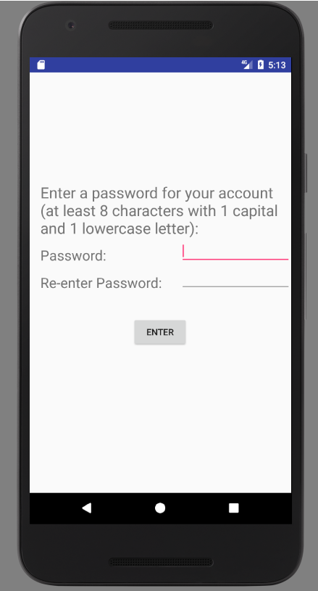
User Interface - Creating an account

Slide 12
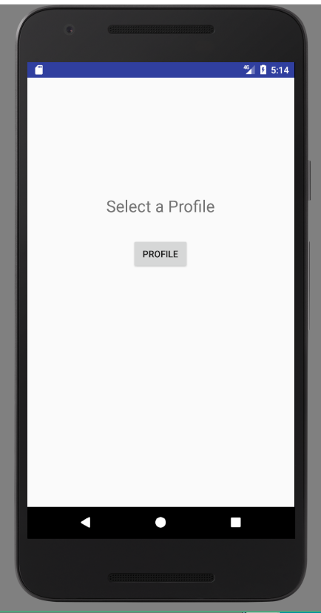
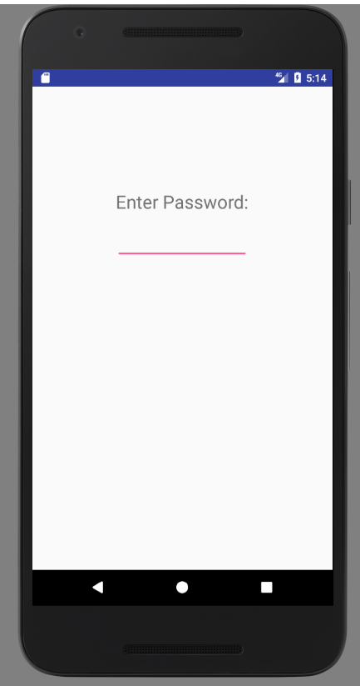
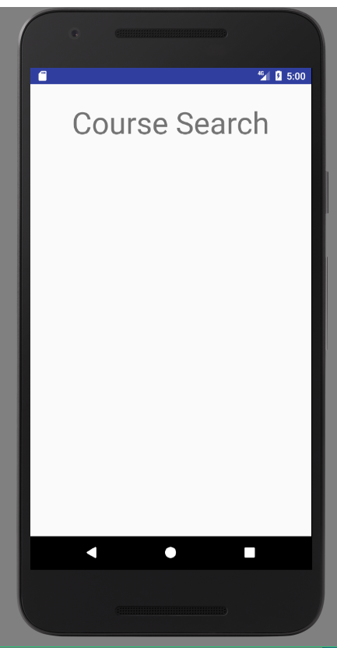
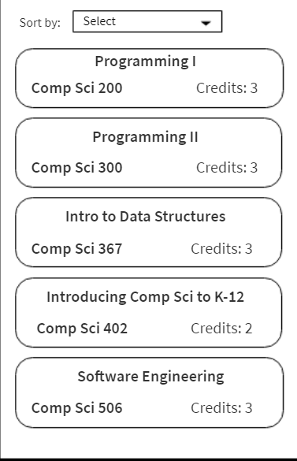
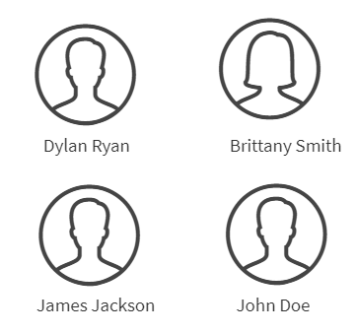
User Interface - Existing account

Slide 13
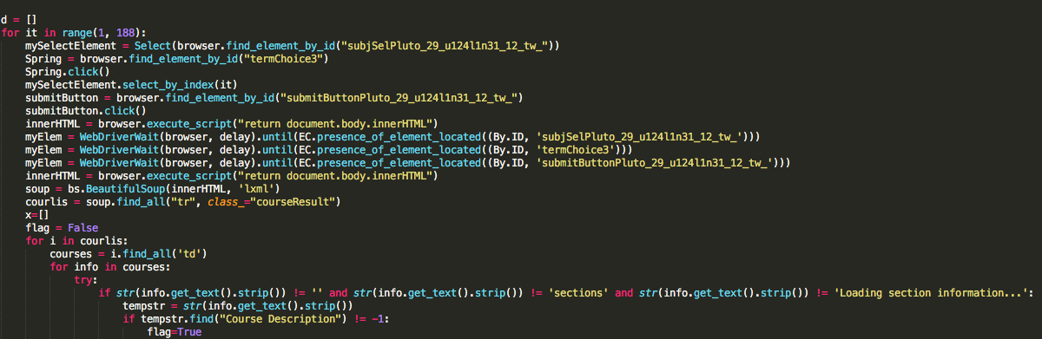
Course Guide Scraper

Slide 14
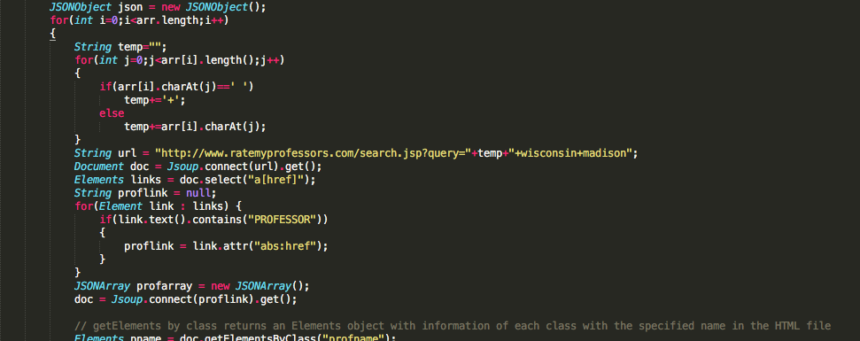
Rate My Professor Scraper

Slide 15
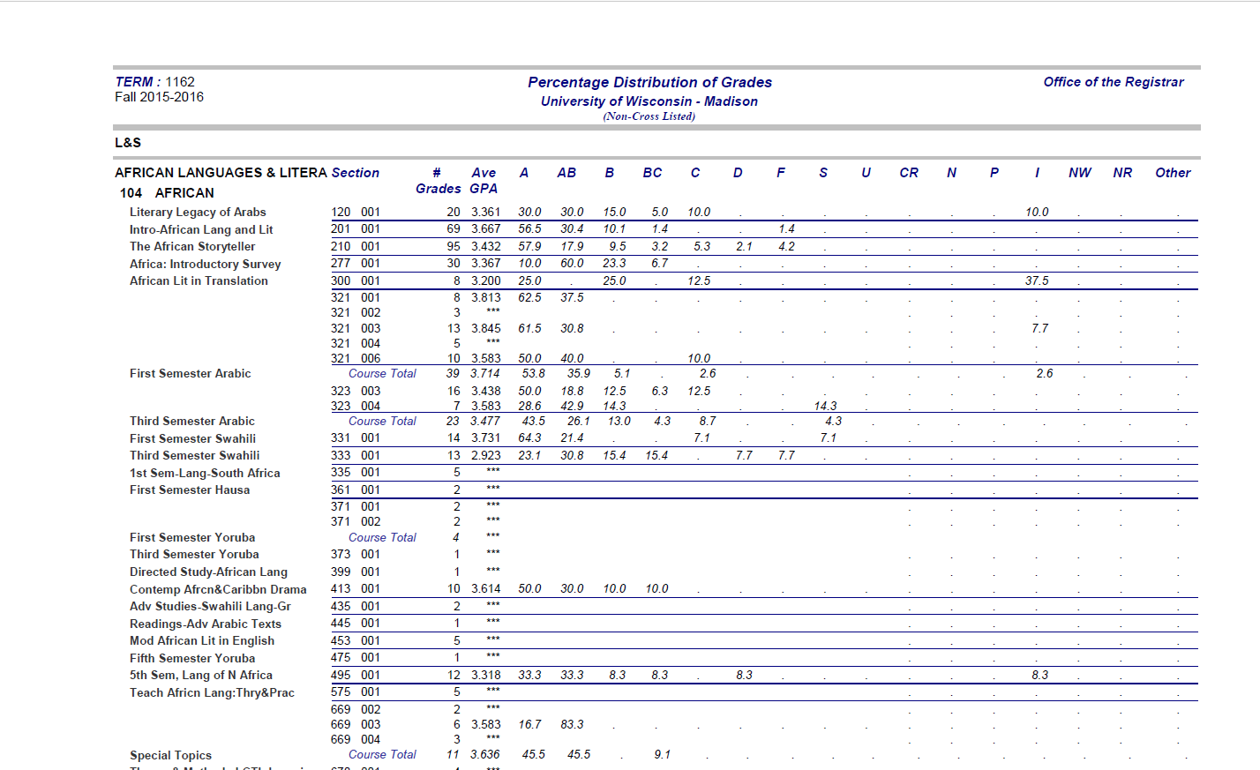
Original PDF file

Slide 16
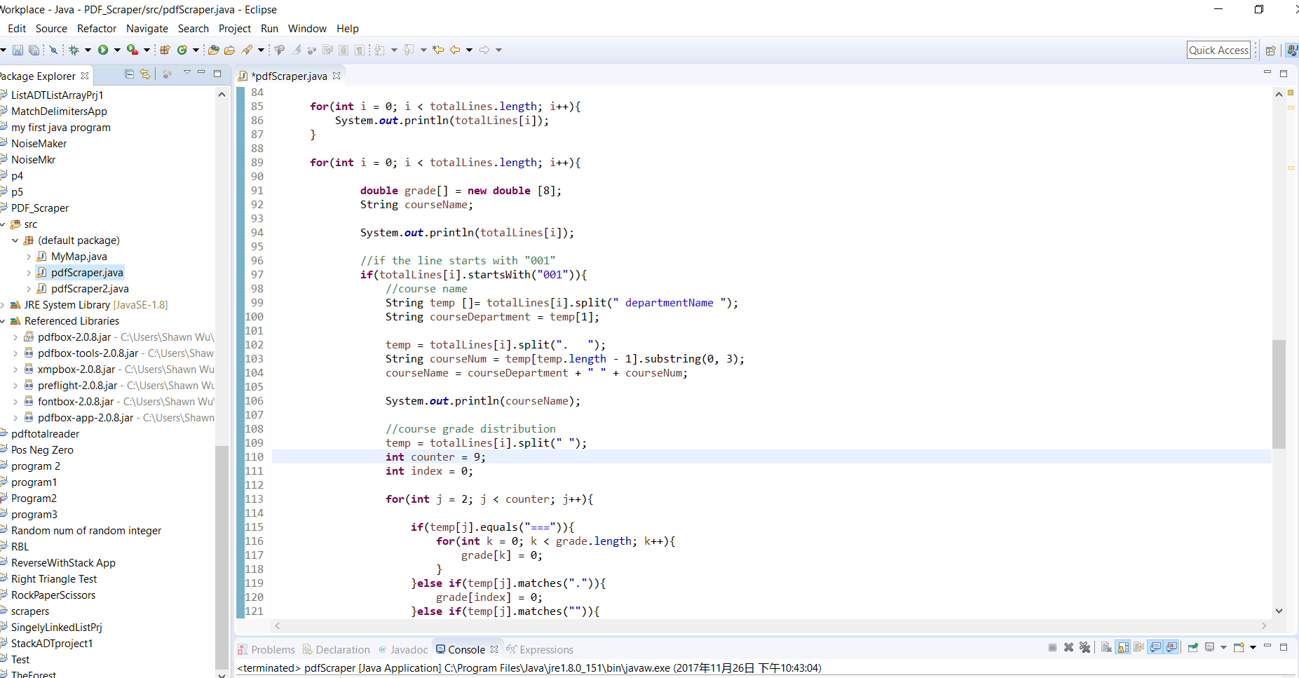
PDF Scraper

Slide 17
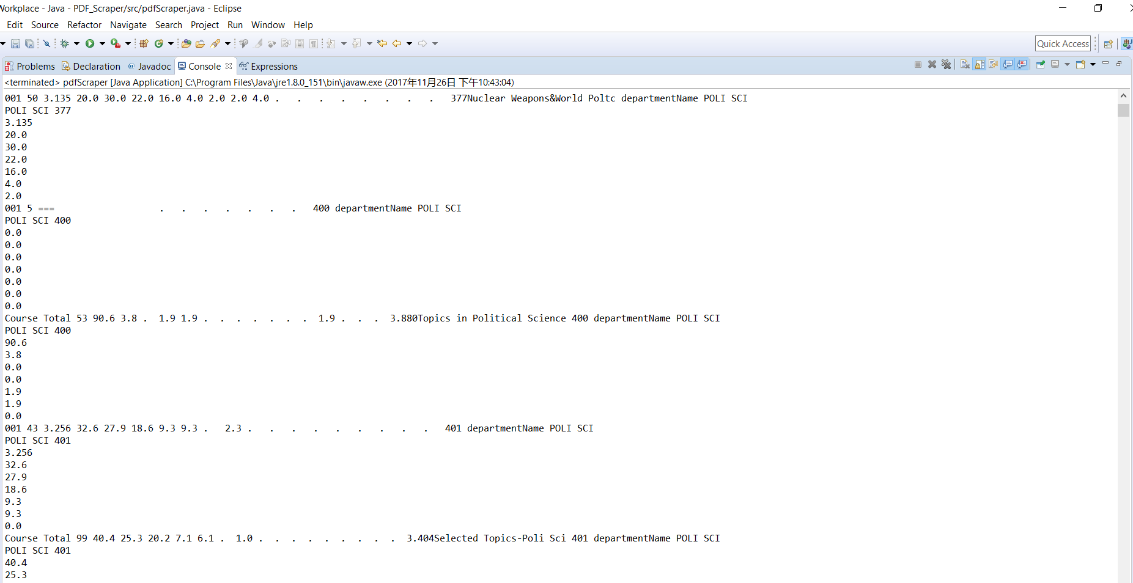
Data that still needs modifications

Slide 18
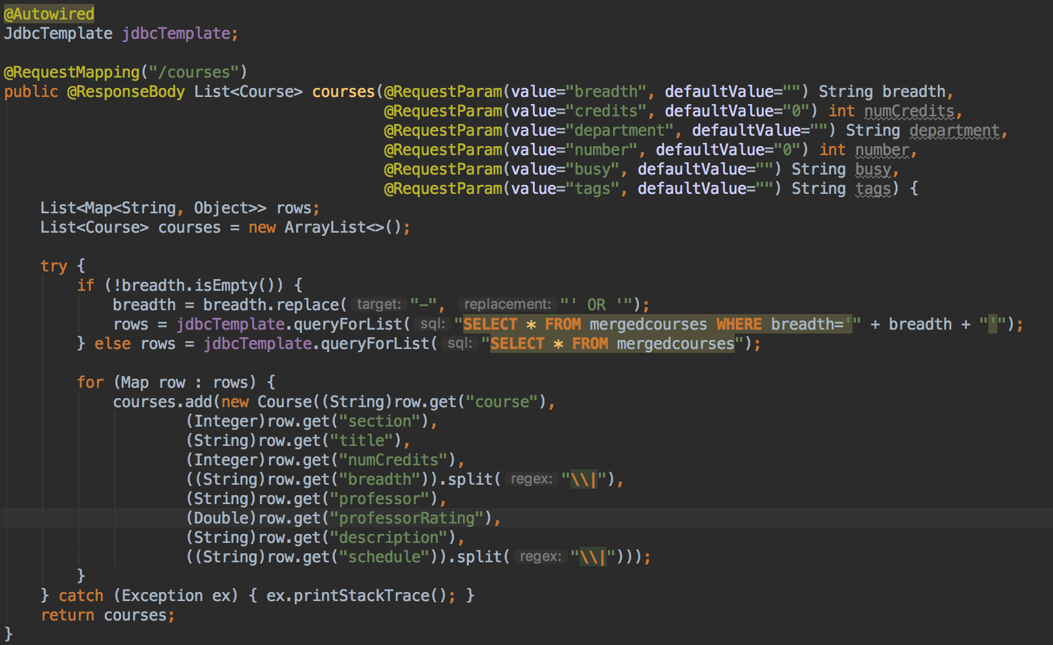
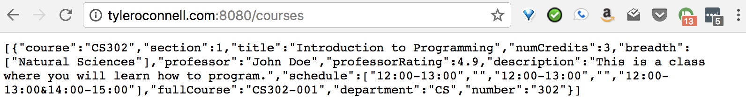
Spring Boot

Slide 19
Difficulties
Setting up the server with KVM and network bridge
Accessing HTML generated by Javascript within scrapers
Use of testing and code coverage tools
Linking of MySQL database and Spring Boot

Slide 20
What was not accomplished (yet)
Dynamically loading data into the frontend for accounts
Integrating the three scrapers with Spring Boot
Add to library
Kickoff
Merge
Final frontend modules
Detailed view
Course progression map

Slide 21
Questions?

